Slide 1

Futurense Technologies
Project Report
Group Name: Brand Builders
Members:
Ashwin – 22BTRAD006
B L N Wajith Ali – 22BTRAD009
Chaithanya Gowda L – 22BTRAD010

Slide 2
Problem Statement 1
Data Cleaning and Augmentation Identify and handle missing values using advanced imputation techniques. Correct anomalies by identifying outliers using statistical methods and domain knowledge. Standardize data formats and ensure consistency across the dataset. Augment the dataset by generating synthetic data using data augmentation techniques and collecting additional data from public sports databases. Integrate this data into a unified dataset.
Purpose: The goal is to ensure that the dataset is clean, consistent, and comprehensive for accurate analysis and insights.

Slide 3
Description
Handling Missing Values: Implemented KNN imputation to address missing data points.
Outlier Detection: Used z-score for statistical anomaly detection.
Standardization: Ensured consistent data formats across all entries.
Data Augmentation: Generated synthetic data and integrated additional data from public databases.
Automation: Created validation scripts to automate the data cleaning process.

Slide 4
Problem Statement 2
Position Analysis Analyze player positions to identify the highest and lowest number of players. Use statistical analysis to determine if the distribution of players across positions is significantly different from a uniform distribution. Create a plot showing the count of players for each position and a pie chart for distribution.
Purpose: The objective is to understand the distribution of players across different positions and determine if it deviates from what might be expected by chance.

Slide 5
Description
Distribution Analysis: Calculated the number of players in each position.
Statistical Validation: Performed a chi-square test to compare observed vs. expected distribution.
Visualization: Created a bar plot and pie chart to illustrate the findings.

Slide 6
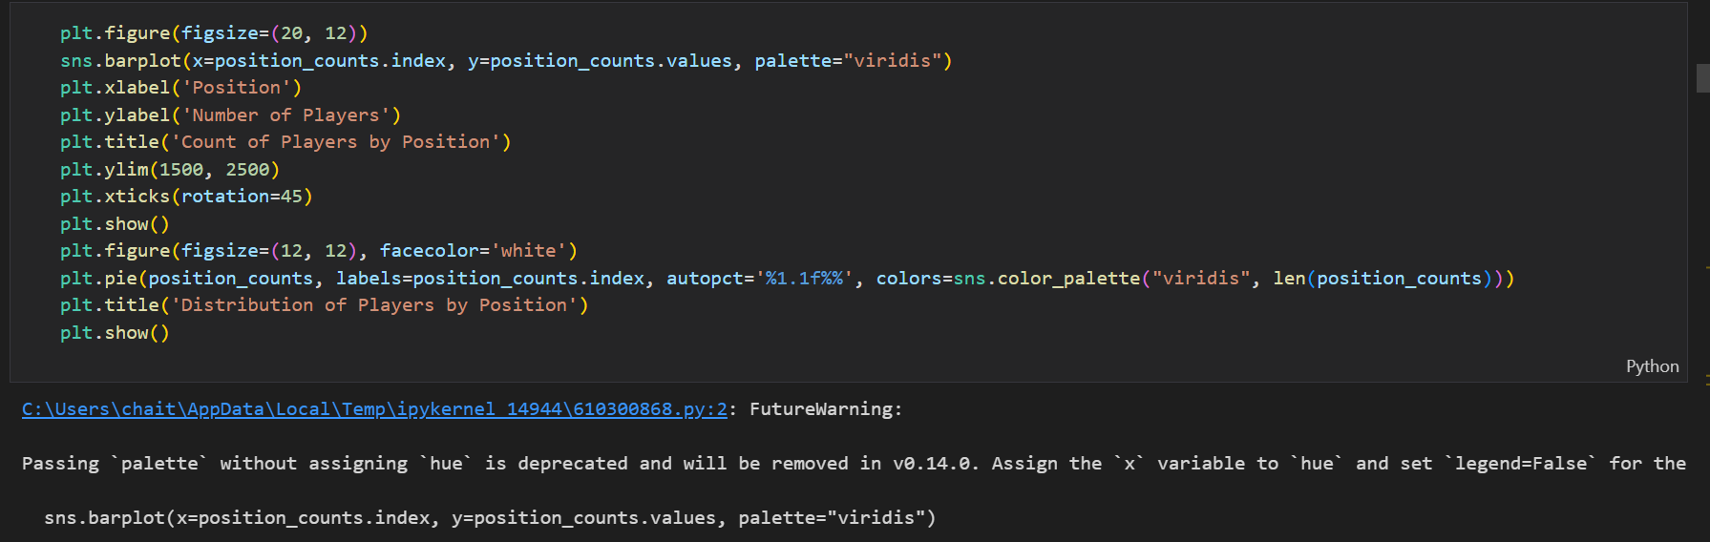
Code
Summary:
Used Pandas for counting player positions.
Visualized results using Matplotlib and Seaborn.
Applied chi-square test using Scipy.

Slide 7
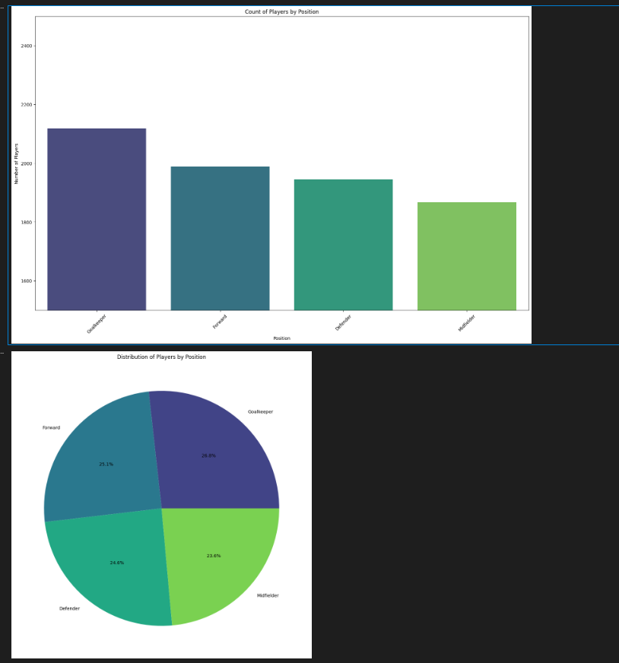
Figures/Graph
Figures:
Bar Plot: Shows the number of players in each position, highlighting which positions have the most and fewest players.
Pie Chart: Illustrates the distribution of players across different positions, providing a visual representation of the proportion each position holds in the dataset.

Slide 8
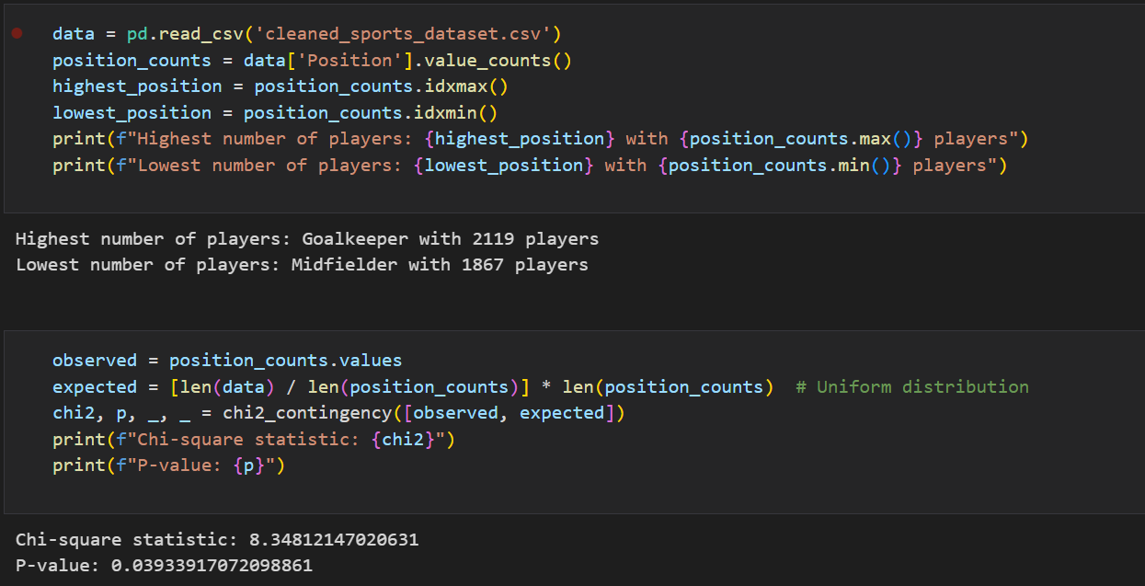
Results(Screenshot)

Slide 9
Problem Statement 3
Data Ingestion Strategies Design and implement a data ingestion pipeline that supports incremental data loading. Optimize storage by using data partitioning and indexing strategies. Implement logging and monitoring to track the performance and reliability of the ingestion process. Utilize Python, Pandas, and SQL for implementation.
Purpose: To efficiently manage and store incoming data, ensuring scalability and reliability for future data operations.

Slide 10
Description
Pipeline Design: Developed a data ingestion pipeline supporting incremental loading.
Optimization: Implemented data partitioning and indexing for optimized storage.
Monitoring: Added logging and monitoring to track pipeline performance.
Parallel Processing: Enhanced performance using parallel processing techniques.

Slide 11
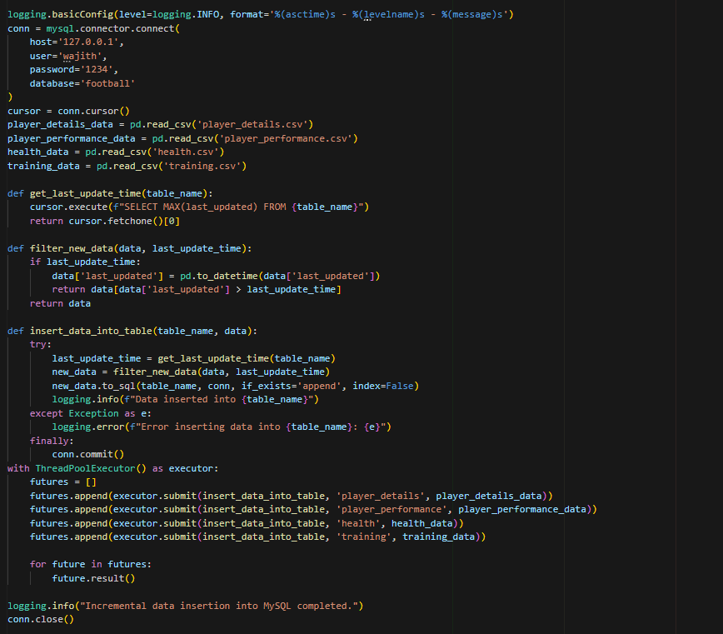
Code
Summary:
Used Pandas for counting player positions.
Visualized results using Matplotlib and Seaborn.
Applied chi-square test using Scipy.

Slide 12
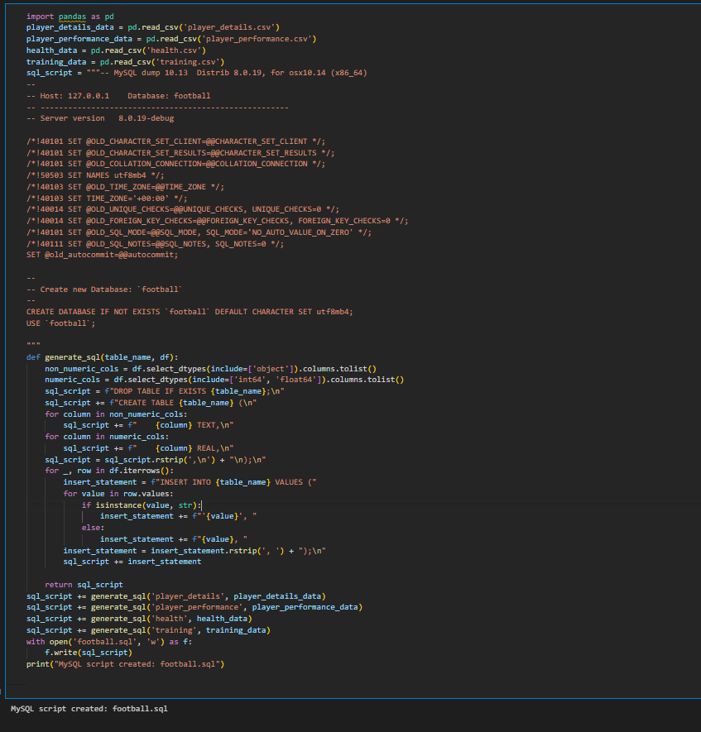
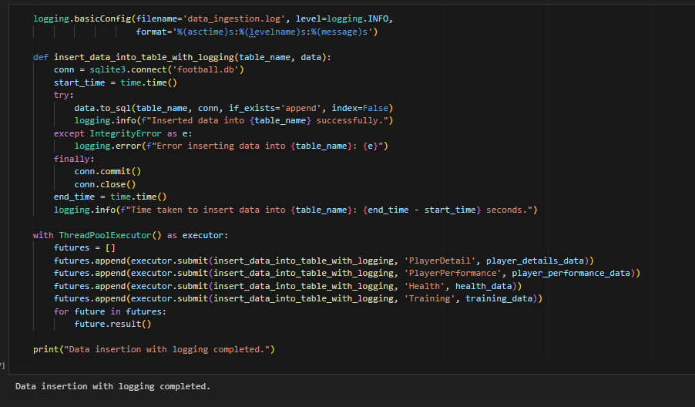
Results(Screenshot)

Slide 13
Problem Statement 4
Pass Completion Rate vs. Assists Analyze the relationship between pass completion rate and assists. Create a scatter plot and identify outliers using advanced outlier detection methods like DB-SCAN or Isolation Forest. Plot a line of best fit and use regression analysis to model the relationship. Evaluate the model using appropriate metrics.
Purpose: To understand how pass completion rates influence the number of assists, and to create a predictive model for this relationship.

Slide 14
Description
Scatter Plot: Created a scatter plot to visualize the relationship.
Outlier Detection: Applied Isolation Forest to identify and handle outliers.
Regression Analysis: Plotted a line of best fit and performed regression analysis.
Model Evaluation: Used cross-validation to assess model robustness.

Slide 15
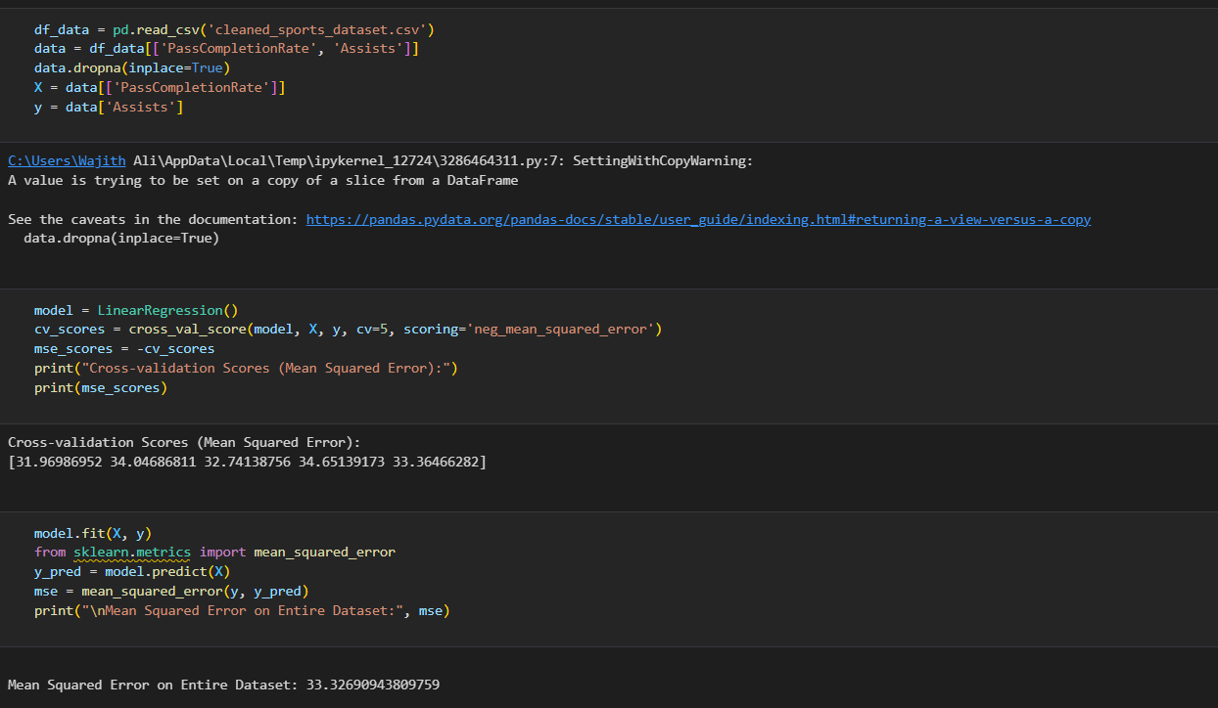
Code
Summary:
Used Pandas and Matplotlib for data visualization.
Applied Isolation Forest from Scikit-learn for outlier detection.
Conducted regression analysis with Scikit-learn.
Evaluated model using cross-validation.

Slide 16
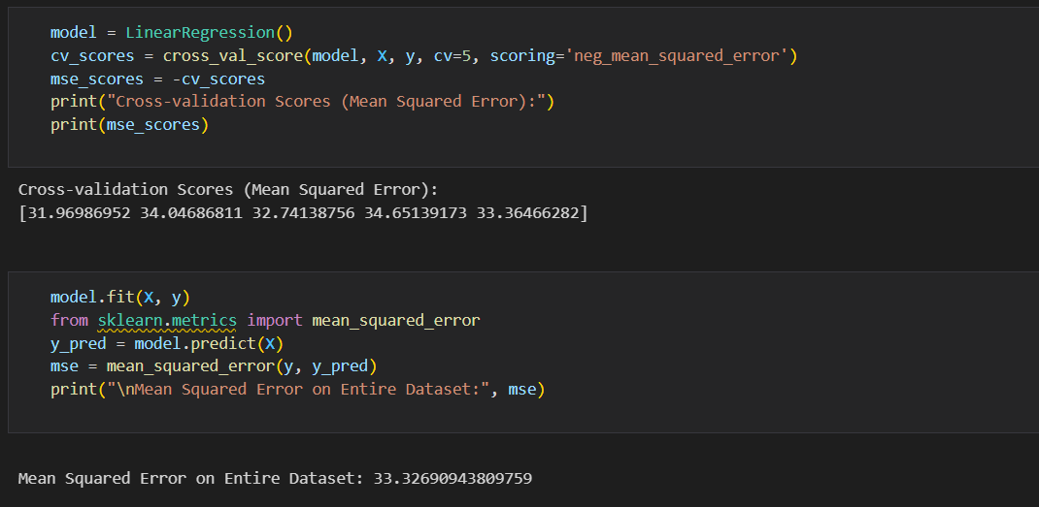
Results(Screenshot)

Slide 17
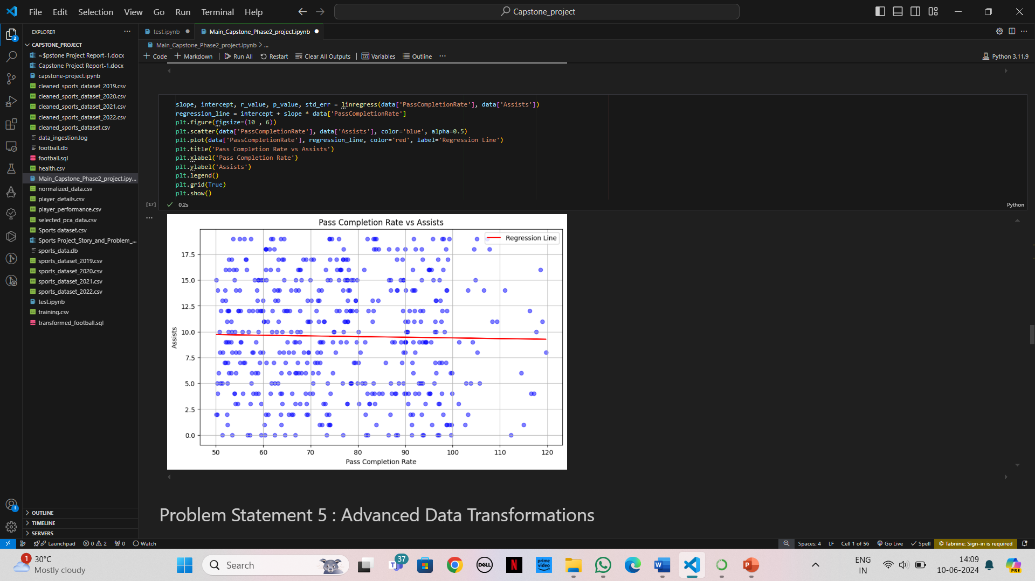
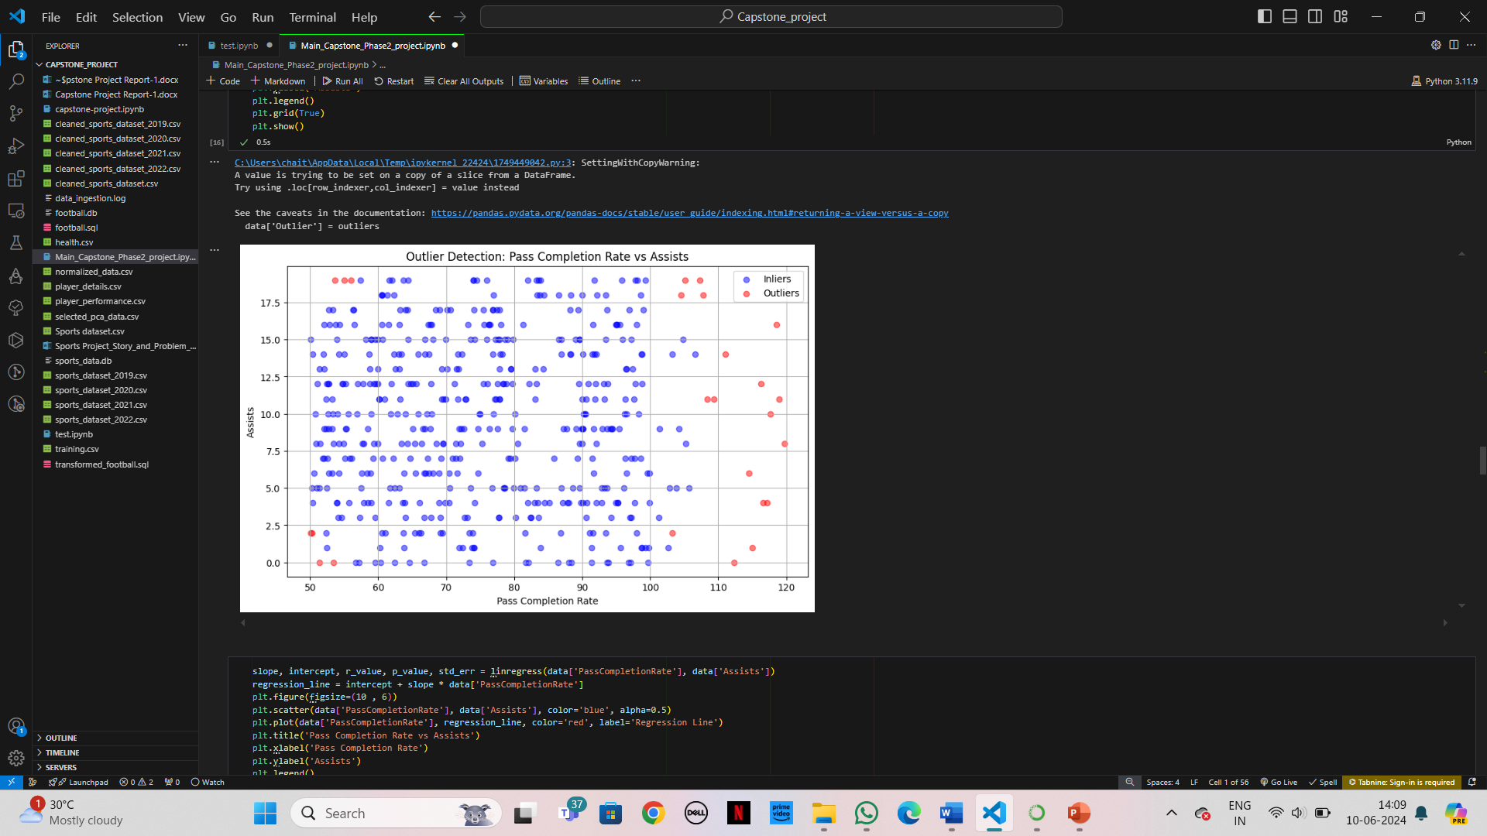
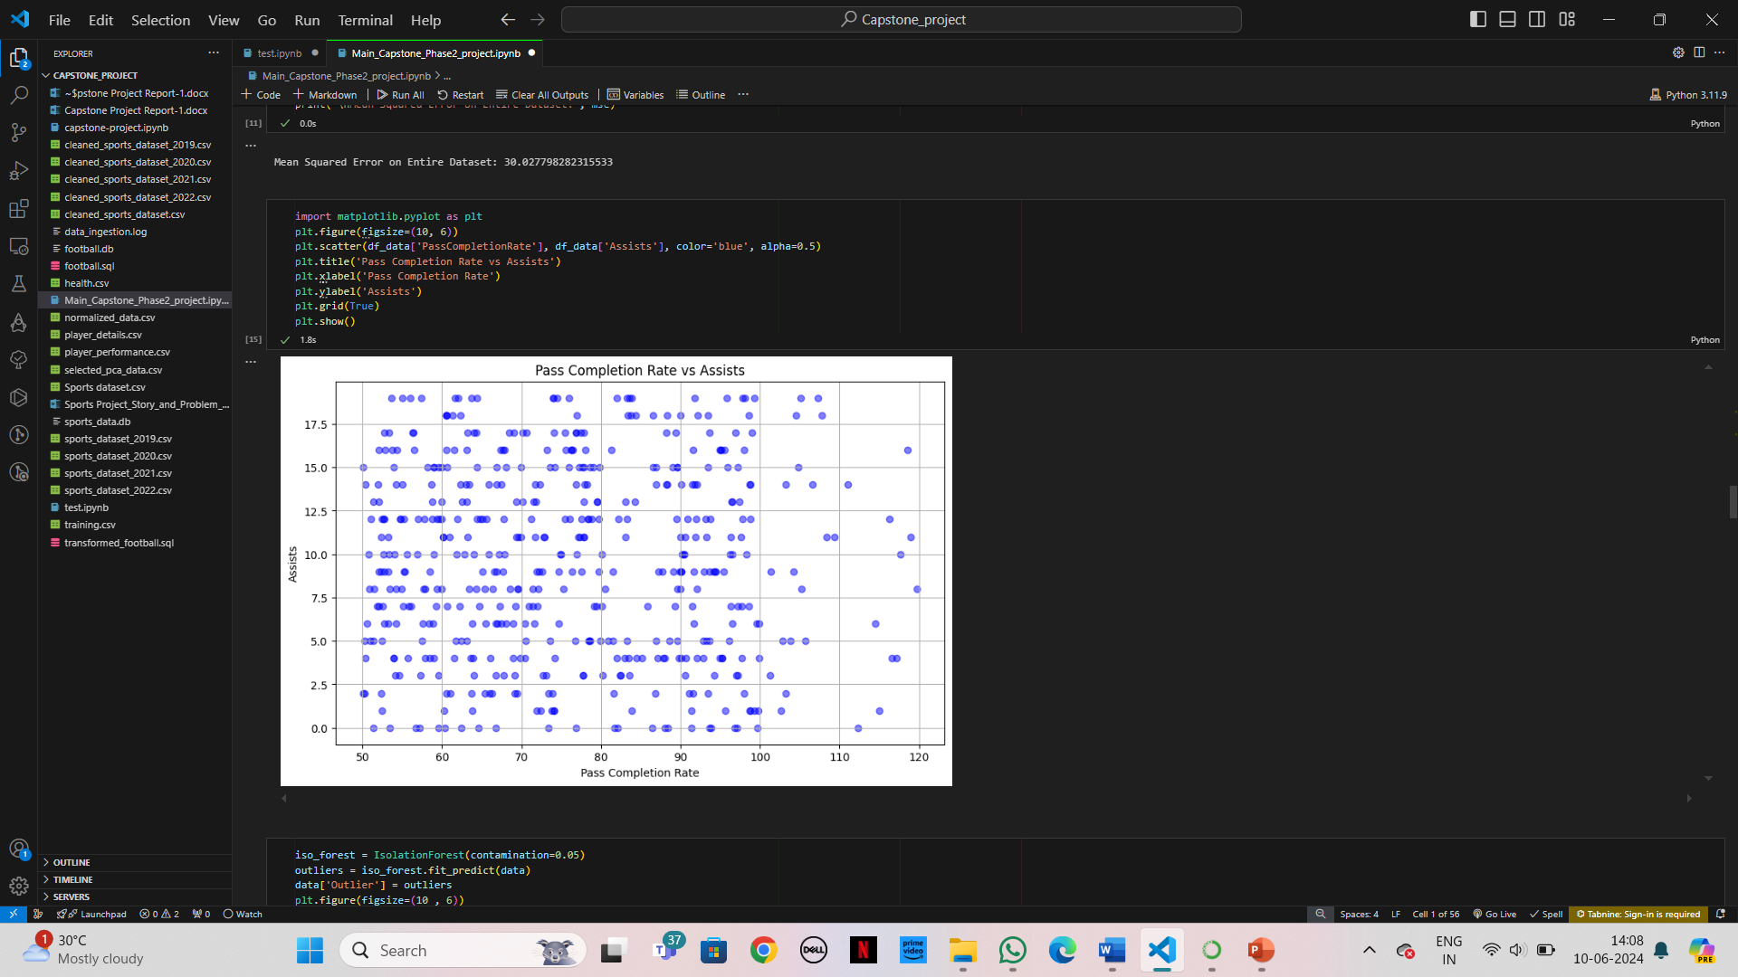
Figures/Graph
Figures:
Scatter Plot: Visualizes the relationship between pass completion rate and assists, helping identify trends and outliers.
Regression Line: Shows the line of best fit, indicating the trend and strength of the relationship.
Outlier Detection: Highlights outliers identified by Isolation Forest, allowing for further investigation.

Slide 18
Problem Statement 5
Advanced Data Transformations Perform complex transformations on the dataset, including feature engineering to create new meaningful features. Implement additional strategies for data optimization, such as data normalization and dimensionality reduction.
Purpose: To enhance the dataset by creating new features and optimizing data for better performance in analytical tasks.

Slide 19
Description
Feature Engineering: Created new features relevant to the analysis.
Normalization: Applied MinMaxScaler to normalize data.
Dimensionality Reduction: Used PCA to reduce the number of features while retaining variance.
Machine Learning: Employed machine learning techniques for feature selection.

Slide 20
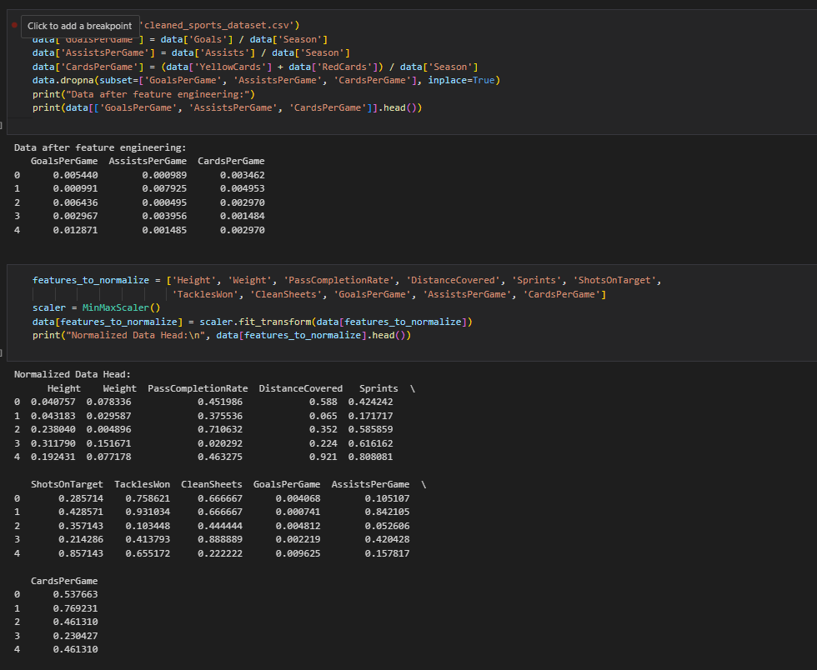
Code
Summary:
Performed feature engineering with Pandas.
Normalized data using Scikit-learn 's MinMaxScaler.
Reduced dimensions using PCA from Scikit-learn.
Used feature selection techniques from Scikit-learn.

Slide 21
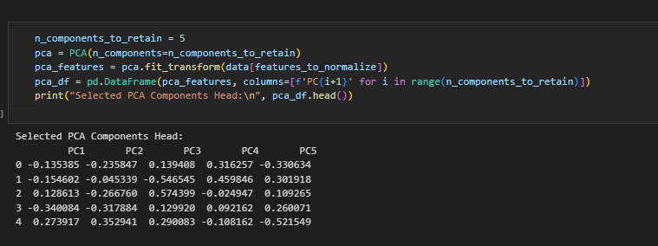
Results(Screenshot)

Slide 22
Problem Statement 6
Data Warehousing Design and implement a data warehouse schema using advanced SQL features like window functions and CTEs (Common Table Expressions). Store the transformed data efficiently and ensure it supports complex analytical queries. Implement data security and access control mechanisms.
Purpose: To create a robust data warehouse that supports efficient data storage, complex queries, and ensures data security.

Slide 23
Description
Schema Design: Developed a schema using advanced SQL features.
Efficient Storage: Optimized data storage with partitioning and indexing.
Complex Queries: Used window functions and CTEs for analytical queries.
Security: Implemented data security and access control measures.

Slide 24
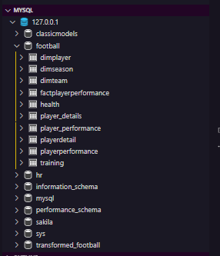
Results(Screenshot)

Slide 25
Problem Statement 7
Team Goals Analysis Identify the team with the highest number of goals. Create a horizontal bar plot and a stacked bar chart. Perform a time series analysis to understand trends in goal scoring over the season. Identify the top goal scorer in that team and analyze their performance metrics over time.
Purpose: To gain insights into team performance, identify key players, and understand goal scoring trends over multiple seasons.

Slide 26
Description
Team Identification: Found the team with the highest number of goals.
Visualization: Created interactive horizontal bar and stacked bar charts using Plotly.
Time Series Analysis: Analyzed goal scoring trends over the seasons.
Top Scorer Analysis: Identified the top goal scorer and analyzed their performance metrics.

Slide 27
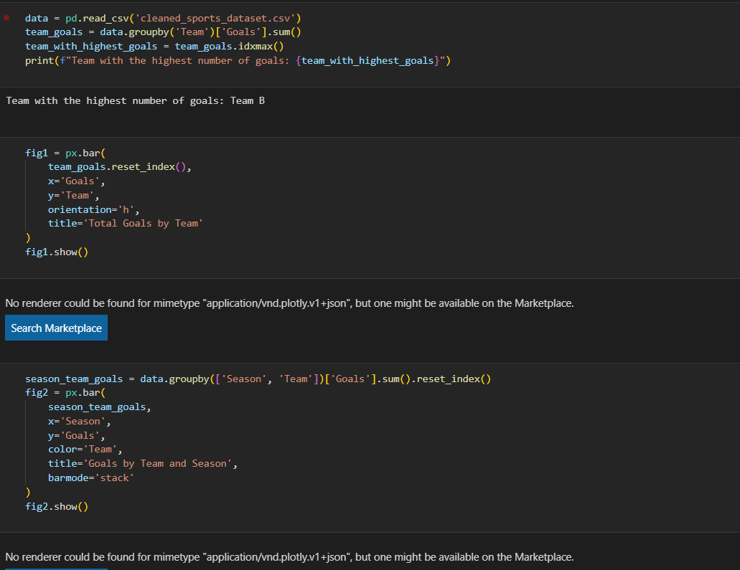
Code
Summary:
Used Pandas for data aggregation.
Created interactive visualizations with Plotly.
Performed time series analysis using Plotly.
Analyzed individual performance metrics with Plotly Graph Objects.

Slide 28
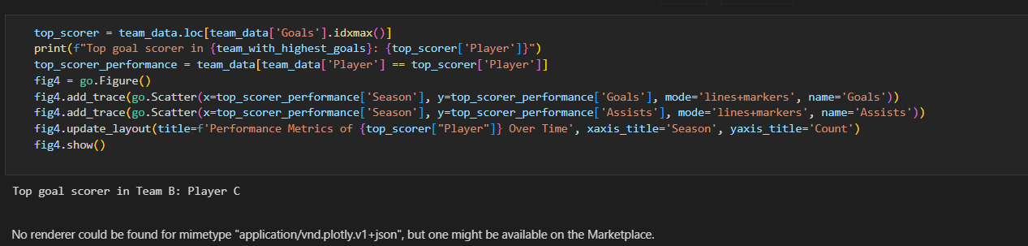
Results(Screenshot)

Slide 29
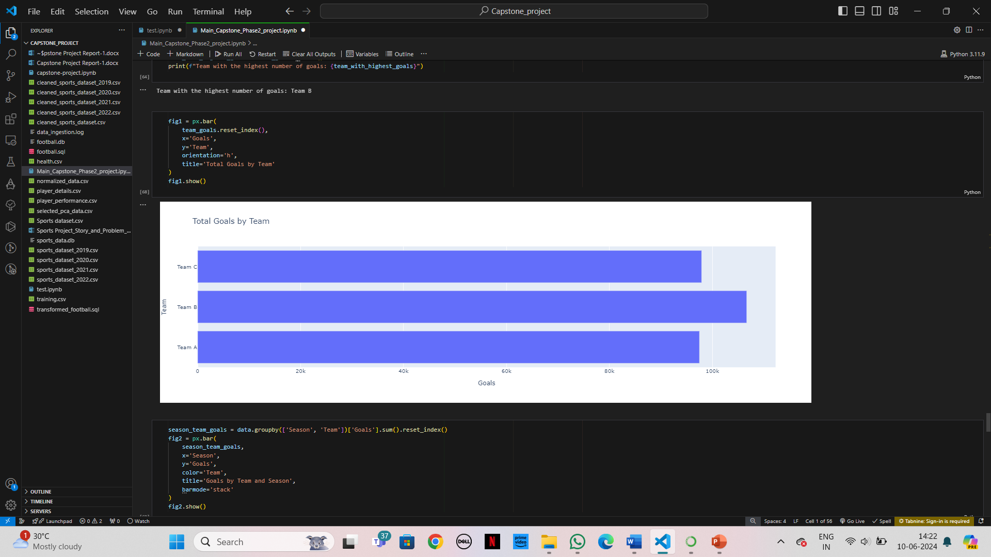
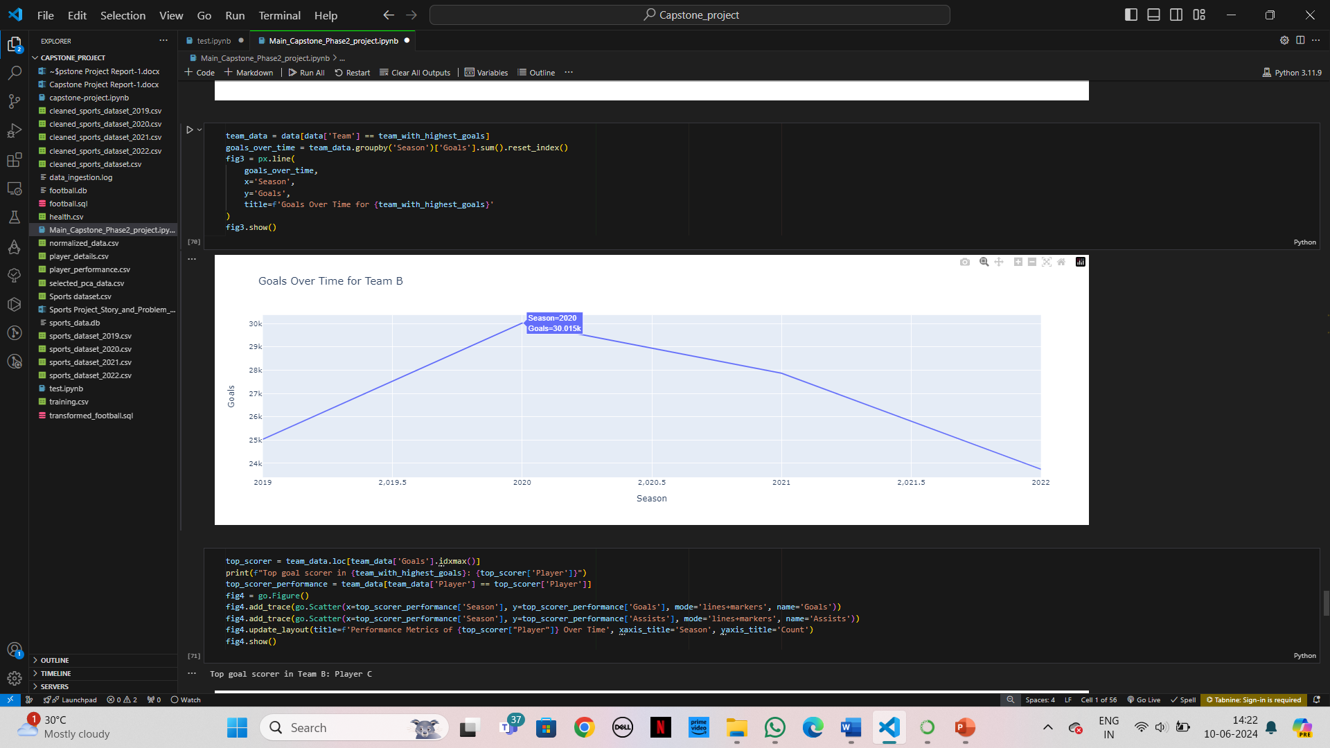
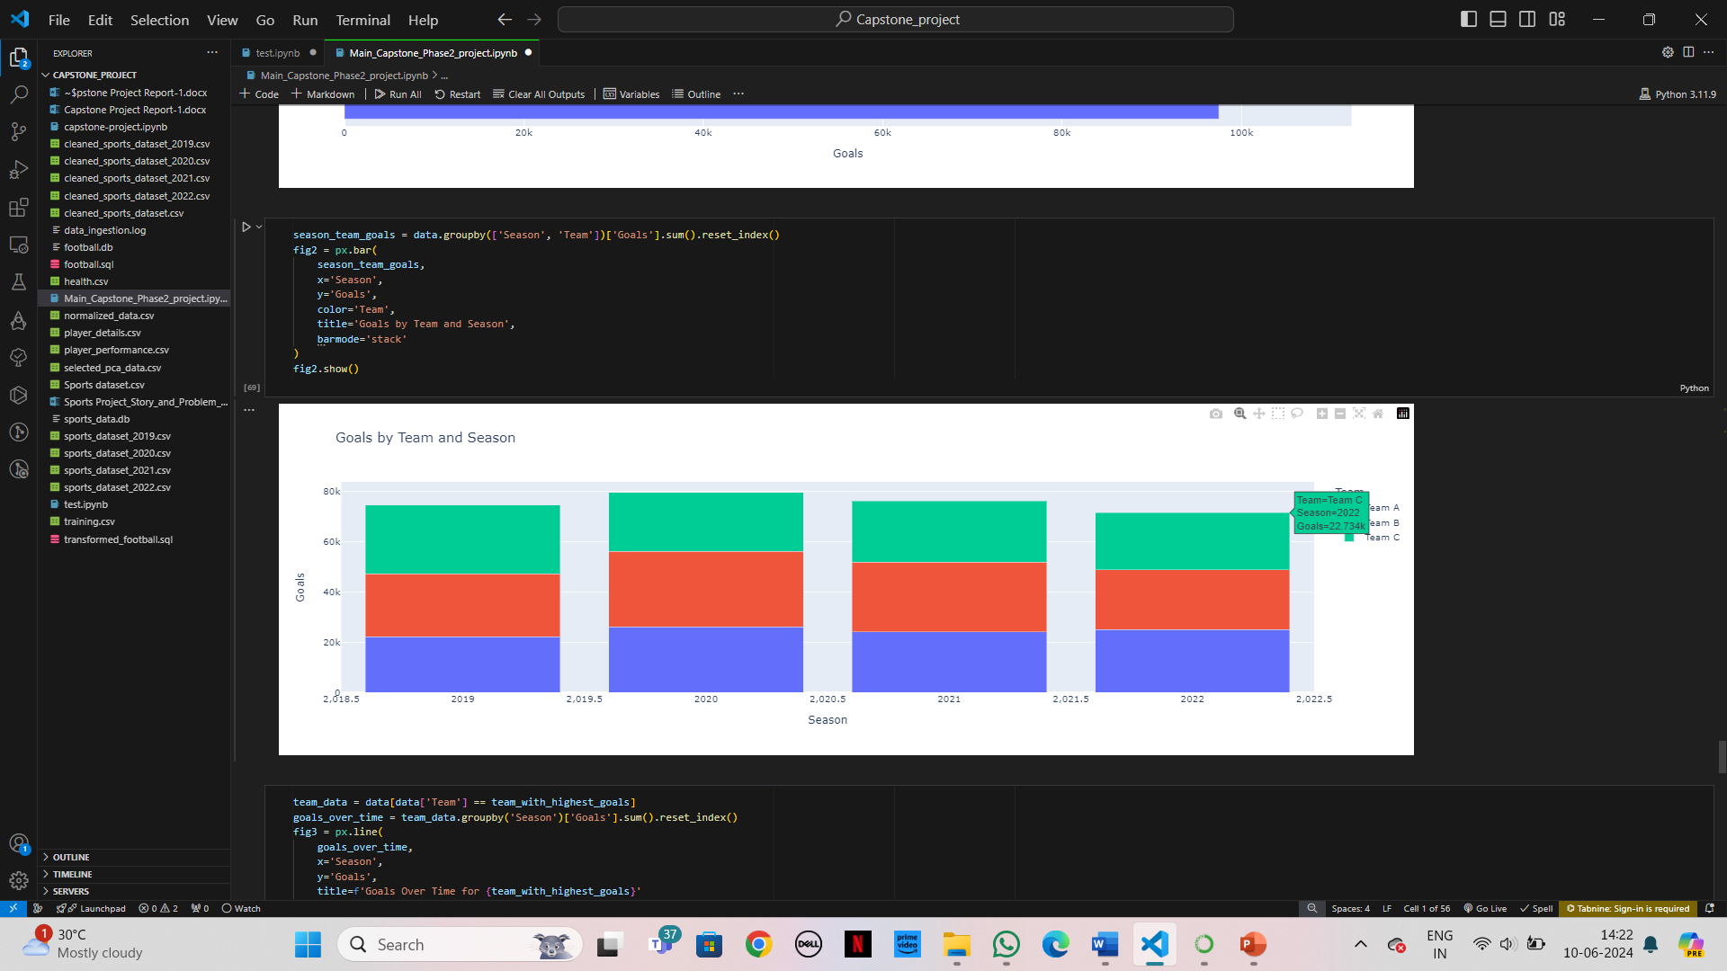
Figures/Graph

Slide 30
Problem Statement 8
Reporting and Visualization Develop interactive dashboards and visualizations using tools like Power BI, Tableau, or custom web applications using Dash or Streamlit. Create reports that provide insights into player performance, team strategies, and potential areas for improvement. Incorporate advanced analytics like clustering and predictive modeling to forecast future performance.
Purpose: To create comprehensive and interactive reports and dashboards that drive business decisions by providing deep insights into the data.

Slide 31
Description
Dashboard Development: Built interactive dashboards using Tableau.
Report Creation: Generated reports with insights on player performance and team strategies.
Advanced Analytics: Applied clustering and predictive modeling for future performance forecasting.
Real-time Integration: Integrated real-time data feeds for dynamic updates.

Slide 32
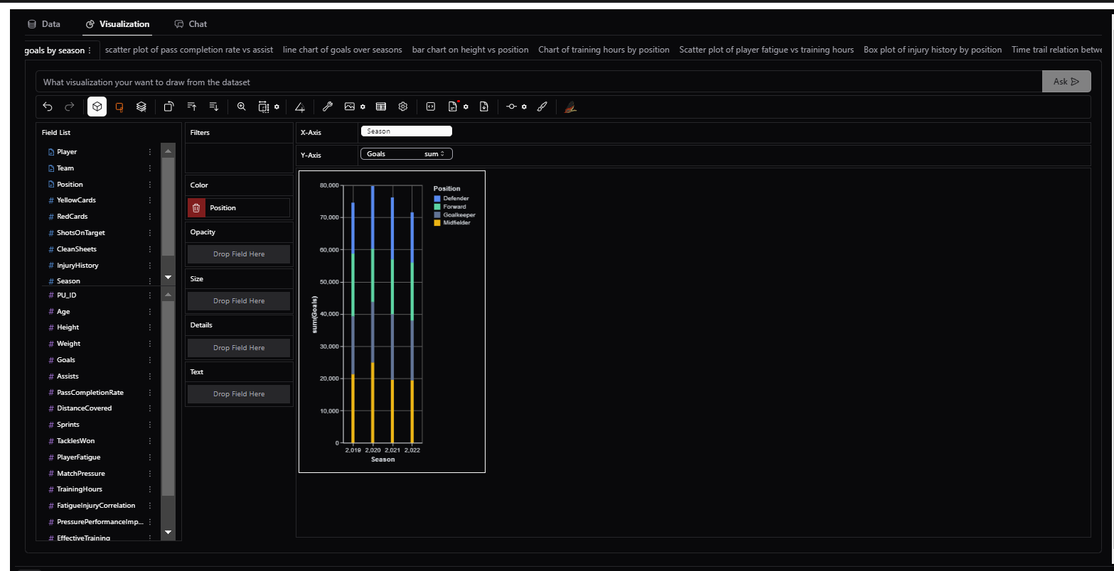
Figures/Graph

Slide 33
References
1. "Data Cleaning: Problems and Current Approaches" Authors: Erhard Rahm, Hong Hai Do
(https://www.researchgate.net/publication/220602798_Data_Cleaning_Problems_and_Current_Approaches)
2. "Introduction to Data Mining" Authors: Pang-Ning Tan, Michael Steinbach, Vipin Kumar
(https://www-users.cs.umn.edu/~kumar/dmbook/index.php)
3. "Machine Learning Yearning" Author: Andrew Ng
(http://www.mlyearning.org/)
4. "Principles of Data Wrangling: Practical Techniques for Data Preparation" Authors: Tye Rattenbury, Joseph M. Hellerstein, Jeffrey Heer
(https://www.oreilly.com/library/view/principles-of-data/9781491938923/)
5. "The Elements of Statistical Learning: Data Mining, Inference, and Prediction" Authors: Trevor Hastie, Robert Tibshirani, Jerome Friedman
(https://web.stanford.edu/~hastie/ElemStatLearn//)
6. "Pandas Documentation" Authors: The Pandas Development Team
(https://pandas.pydata.org/pandas-docs/stable/)
7. "Altair: Declarative Visualization in Python" Authors: Jake VanderPlas, Brian Granger, Jeffrey Heer, Dominik Moritz
(https://altair-viz.github.io/)
8. "Design and Implementation of Data Warehouses" Authors: Matteo Golfarelli, Stefano Rizzi
(https://link.springer.com/book/10.1007/978-3-540-26641-0)

Slide 34
Thank you!!!

